Slide 1

© WFP / Arlette Bashizi
Customer Protection Training
[Partner1 Logo]
[Partner2 Logo]
[Date]
Notes:
What is ‘customer protection’? Why do you think it is important for your work?

Slide 2
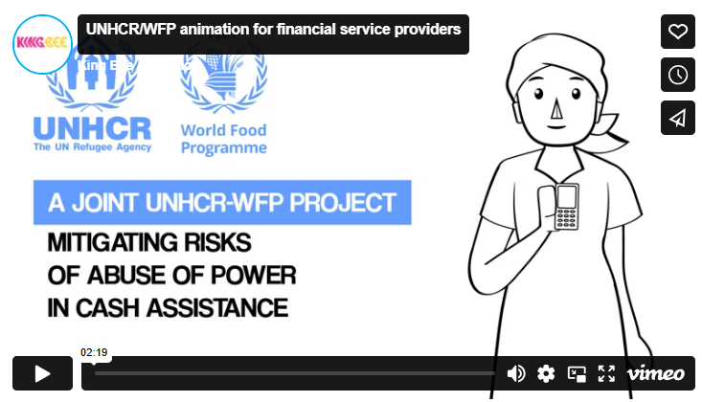
Watch the video here: https://vimeo.com/309084196

Slide 3
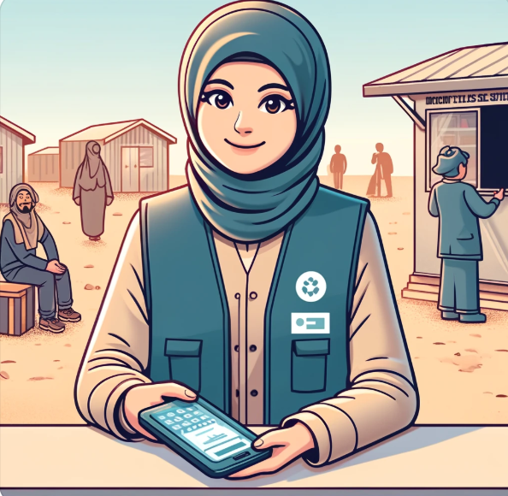
How can we keep our clients safe?
1
CODE OF CONDUCT
2
GOOD PRACTICES TO ADOPT
3
BAD PRACTICES TO AVOID
4
COMPLAINT MANAGEMENT
5
WHAT HAPPENS IN CASES OF MISCONDUCT?

Slide 4

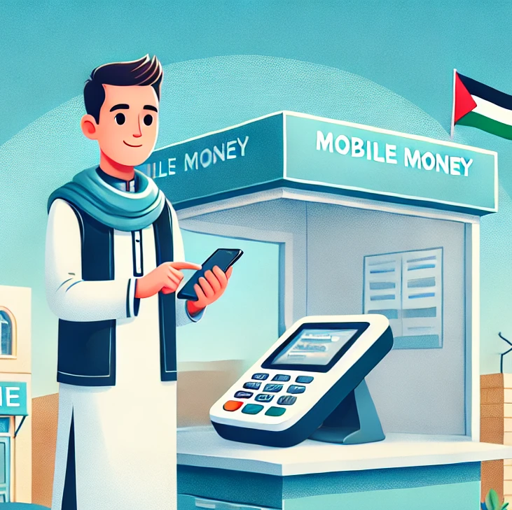
How can this benefit your business?
Sara, a single mother who doesn’t know how to read very well, walks into Ahmed’ shop, the nearby mobile money agent to deposit money for her child’s school fees. She’s nervous because she’s not sure how the process works.
Ahmed greets Sarah warmly, explains the process in simple terms and charges a proper fees with no hidden costs. He provides Sara with a receipt and keep her details private. Sara feels comfortable and trusts him. She knows her money is safe and that Ahmed won’t misuse her information.
Ahmed refuses any side-deals or special “extra fees.” Sara sees he is honest and doesn’t feel pressured. If any mistakes occur or if someone else tries to charge her unfairly, he intervenes. Sara sees that Ahmed cares about her wellbeing, so she returns for other services.
LET’S BRAINSTORM: HOW CAN AHMED’S BEHAVIORS HELP HIS BUSINESS?

Slide 5
You got this! Here are a few additional business benefits…
1
MORE LOYAL CUSTOMERS WHO RECOMMEND OTHERS
2
STRONGER REPUTATION
3
REDUCED RISKS AND LEGAL PENALTIES
4
HIGHER EMPLOYEE MORALE AND LOWER STAFF TURNOVER
5
STRONGER PARTNERSHIPS WITH LARGER FIRMS, BANKS, SUPPLIERS
6
BETTER ACCESS TO CREDIT
7
LONG-TERM GROWTH
8
INCREASED SALES AND CROSS-SELLS
Notes:
Note to moderator:
More Loyal Customers: Being respectful (especially to vulnerable clients) and fair encourages people to trust you. They feel safe, return to transact again, and recommend you to their friends.
Stronger Reputation: Following laws, avoiding corruption, and keeping private information safe shows that you run a clean, honest business. A good reputation draws in new customers and partners.
Reduced Risks and Penalties: Sticking to regulations and speaking up when something’s wrong helps you avoid legal problems. Fewer fines or shutdowns mean you can focus on growing your business.
Higher Employee Morale: Being responsible and transparent with customers and staff makes employees proud to work for you. Happy staff often give better service, which boosts customer satisfaction and sales. Employees want to work for a business they can respect. Ethical practices lead to higher morale and less time spent hiring or training new staff.
Stronger Partnerships: When you’re known to follow regulations and act fairly, larger firms, banks, and suppliers are more willing to collaborate with you.
Better Access to Credit: Lenders prefer businesses with strong ethics and clear records, so you’re more likely to secure loans and investment.
Long-Term Growth: With fewer legal issues and a solid reputation, you can focus on expansion. The trust you build encourages new customers to try—and keep using—your services.
Increase sales and cross-sells: Customers are returning and are also buying other products in your shop than just mobile money services. For instance, you could offer other services like suggesting phone airtime or small savings accounts when someone comes to withdraw funds.

Slide 6

Code of conduct: Remember these 8 principles
1
I AM RESPECTFUL TO ALL MY CLIENTS
2
I AM PATIENT AND FAIR
3
I DO NOT EXPLOIT OR ABUSE MY CLIENTS
4
I FOLLOW THE RULES AND LAWS
5
I KEEP MY CLIENTS’ PRIVATE INFORMATION SAFE
6
I SAY NO TO BRIBES AND CORRUPTION
7
I AM RESPONSIBLE AND TRANSPARENT
8
I SPEAK UP IF SOMETHING IS WRONG

Slide 7
Let’s look at some examples!
An elderly lady approaches your colleague to ask for help. She has already come three times to see you and your colleagues this week. She does not speak your language very well.
Your colleague loses his patience and shouts at her to go away. There are a lot of other people waiting in line to get help.
IS THERE A PROBLEM? WHAT DO YOU DO?

Slide 8
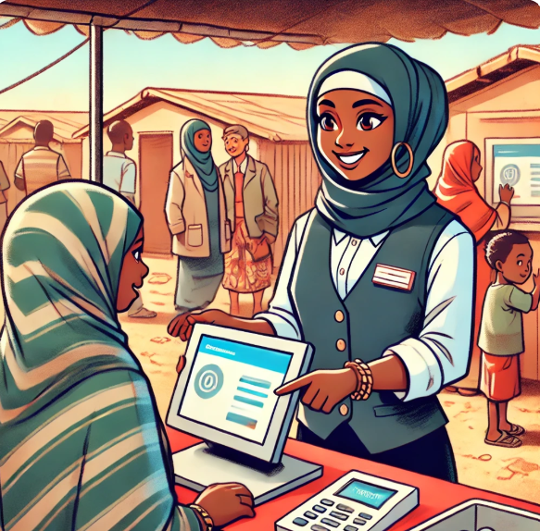
Code of conduct: Let’s put it into practice!
1
I AM RESPECTFUL TO ALL MY CLIENTS
Why is it important?
Clients may lack the safety and familiarity they previously enjoyed in their country or community.
All clients deserve to be treated with the same customer care, regardless of their sex, origin or background
For example, a client may have recently fled from their home and is exhausted and afraid.
What does it mean for you?
Always be respectful and considerate towards clients.
Degrading comments or behaviour is not acceptable.
Remember, what you say and how you say it matters.
Think about how you would like to be treated.

Slide 9

Code of conduct: Let’s put it into practice!
2
I AM PATIENT AND FAIR
Why is it important?
Clients may use financial services for the first time and not be familiar with procedures.
For example, a client may not speak the local language or not know how to read.
What does it mean for you?
Give all clients clear and concise information and make sure all communications are understood
Remember, it is the duty of everyone to ensure fair treatment of all clients without discrimination.

Slide 10
Let’s look at some examples!
You see a woman leaving the [select: shop/branch/distribution point] agitated and upset.
When you approach her to ask what was wrong with her, she informs you that a person working there tried to kiss her.
IS THERE A PROBLEM? WHAT DO YOU DO?

Slide 11
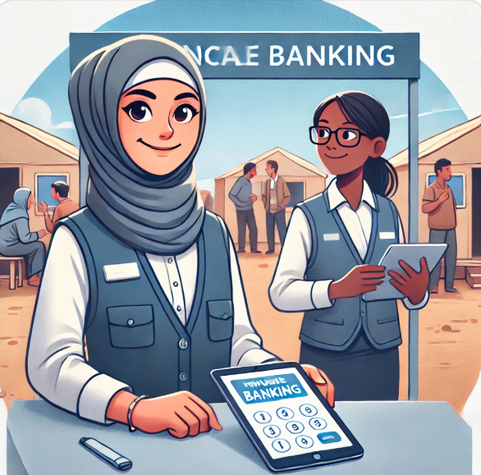
Code of conduct: Let’s put it into practice!
3
I DO NOT EXPLOIT OR ABUSE MY CLIENTS
Why is it important?
As financial service provider you are in a position of power, it is essential to ensure your client’s safety, dignity and trust.
For example, elderly or illiterate clients may depend on you to access cash assistance.
What does it mean for you?
Any form of exploitation and abuse towards clients, including of a sexual nature, is not tolerated.
Remember, you must not engage in any sexual activities with clients in return for the services you provide.
What is Sexual Exploitation and Abuse (also known as SEA)? It means that humanitarian workers OR Financial Service Providers takes advantage of a client in a sexual way. This means they use their position to pressure, trick, or force someone into doing something sexual or threats to withholding assistance/service in exchange for a favour. Both is wrong and not allowed.

Slide 12
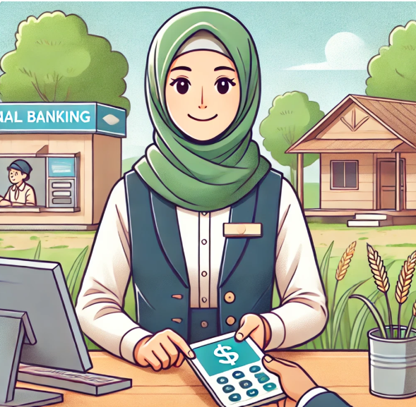
Code of conduct: Let’s put it into practice!
4
I FOLLOW THE RULES AND LAWS
Why is it important?
Compliance with applicable laws, regulations, policies and standards is a personal responsibility.
For example, a client may not know what is considered illegal.
What does it mean for you?
Follow the rules and laws that apply to your work.
Do not ask your clients for any undue fees.
Remember, failure to respect laws and policies may lead to loss of clients, loss of business, or penalties.
Example: A person comes to my shop to open a mobile money account, she says she doesn’t have her ID on her but wants you to use her sister's ID instead. You accept provided she gives you 10 USD. Is there a problem? Why?

Slide 13
Let’s look at some examples!
You overhear your colleagues talking about work over a drink in the evening.
One of them tells you that he got many people to share their PIN/password with him as they don’t know how to operate their phone themselves. He saw that [Mr./Mrs. X] received a lot of money this week!
IS THERE A PROBLEM? WHAT DO YOU DO?

Slide 14
Code of conduct: Let’s put it into practice!
5
I KEEP MY CLIENTS’ PRIVATE INFORMATION SAFE
Why is it important?
As part of delivering financial services, you may receive confidential information or clients’ personal data.
For example, your logbook of transactions contains sensitive information about your clients.
What does it mean for you?
Take care in handling people’s personal data and do not share it with others without authorization.
Remember, building/maintaining trust is an important part of your relationship with clients.
Use digital logbooks wherever possible to protect data better.

Slide 15
Let’s look at some examples!
You are working on a cash transfer in a rural area today. The connection has been bad and the systems are slow.
Many people have stood in line for hours to receive their assistance. One of them approaches you and tries to give you a small amount of money. He is desperate because he needs to go back to work so he asks if he can move to the front of the line.
IS THERE A PROBLEM? WHAT DO YOU DO?

Slide 16
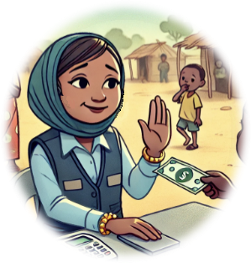
Code of conduct: Let’s put it into practice!
6
I SAY NO TO BRIBES AND CORRUPTION
Why is it important?
Accepting or requesting bribes or offers of favours is unacceptable, dishonest, and damaging.
For example, a client may propose to give you money or a gift in return for your speedy provision of services.
What does it mean for you?
Do not accept or request gifts or favours from clients. Reject bribery and corruption in all forms.
Remember, positive client relationships can and should be developed free of bribery and corruption.

Slide 17
Let’s look at some examples!
Sometimes you ask yourself why you need to display those fee schedules – more than half of the people that come to see you cannot or do not read them!
Anyway, you sometimes ask your clients in remote areas to give you a little commission because you are taking all the risk to carry the money there.
IS THERE A PROBLEM? WHAT DO YOU DO?

Slide 18

Code of conduct: Let’s put it into practice!
7
I AM RESPONSIBLE AND TRANSPARENT
Why is it important?
Provision of financial services is based on integrity and trust as perceived by clients and other stakeholders.
For example, a client may not fully understand the applicable fees and trusts that you apply them correctly.
What does it mean for you?
Act ethically, responsibly, professionally and with integrity at all times. Set a good example.
Always display fees and your company identification/badge
Display hotline numbers so that all clients can see them.
Ensure that information is accessible through different channels: posters and leaflets with pictures, in different languages, through videos, social media, or radio.

Slide 19
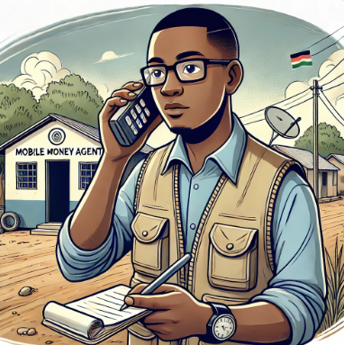
Code of conduct: Let’s put it into practice!
8
I REPORT CONCERNS AND COMPLAINTS
Why is it important?
Everyone has an important role to play complying with standards and raising possible issues.
For example, you may see a colleague of yours shout at or threaten a client.
What does it mean for you?
If you see anything that does not feel right, you have to speak up and report it.
Remember, you must report any potential issues as soon as you notice them.
Make sure you know what numbers to call for customer issues, including sensitive complaints.
Call [insert phone number]

Slide 20
Recap: Can you think of good practices to adapt?
✔
The below is for the facilitator only:
Greet and treat clients with the same respect as anyone else. Remember the 8 Code of Conduct principles?
Give people adequate time and attention. Some people may need more of your time. Be welcoming especially to women, elderly persons, and persons with disabilities.
Communicate clearly and in a language that the person understands.
Always display available posters and brochures explaining fees/costs, processes and hotlines for people to get help.
Always display your company identification e.g. ID/badge.
Be patient when you are sharing information. Some people are first-time clients.
Address every question – be mindful of people’s digital financial literacy levels and provide appropriate solutions based on their level.
Guide people through how to use services/solve problems – multiple times if necessary – rather than doing it for them.
Never disclose a customer’s personal data to unauthorized personnel, such as contact number, balance information.
Assure people about the security of their accounts. Do advocate for keeping PIN codes and passwords secret - this can prevent fraud
Educate people about the benefits of financial services. Inform them about other products that might add value for them (loans, insurance etc).
Redirect people if you don’t know the answer. Always refer people if they disclose sensitive issues to you (see below). Do not pry and be discreet.
Notes:
Let people speak first then show examples – this is just a summary with examples to recap

Slide 21
Recap: What are bad practices to avoid?
x
The below is for the facilitator only:
Do not behave disrespectfully towards clients or undermine their dignity: Do not act arrogantly, refuse to listen, or ignore legitimate questions about ongoing operations. Do not insult, mock, or verbally abuse people.
Do not arrive late at the payment point or start operations late without a valid reason or notice.
Do not tolerate unethical behavior or discrimination (ethnic, religious etc.).
Do not apply different rates or refuse to serve a client as a form of punishment.
Do not refuse to answer client questions or provide false information.
Do not abuse or exploit clients by seeking financial, material, or sexual favors.
Do not commit fraud or corruption.
Do not fail to report any cases if something feels wrong, even if you are not sure. It does not matter who is involved (your colleague or any humanitarian staff), you always report.
Do not threaten retaliation against anyone who files a complaint or report.
Never disclose a customer’s personal data to unauthorized personnel, such as contact number and balance information.
Notes:
Summary to recap!

Slide 22
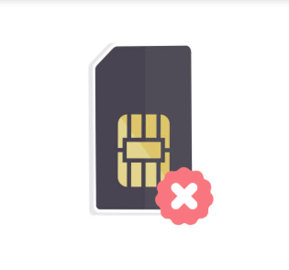
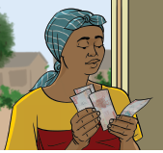



Let’s look at complaints!
IS IT A SENSITIVE COMPLAINT? CAN YOU SOLVE THE PROBLEM?
x
A women approaches you about a blocked sim card/bank card/e-wallet
Your colleague intimidates and verbally abuses assistance recipients
People did not receive the expected quality or quantity of the bank notes given
Notes:
Technical
Sensitive
Sensitive (can account to fraud!)

Slide 23


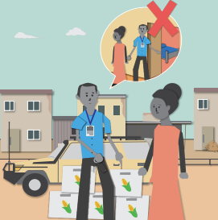
Let’s look at complaints!
IS IT A SENSITIVE COMPLAINT? CAN YOU SOLVE THE PROBLEM?
You and your colleagues arrive late which means people receive their assistance late
Assistance meant for child-headed households is forcefully taken by adults in the community
A community member reports to you that a NGO staff member requested sexual favors in exchange for providing assistance
Remember: You always need to log/record the complaint. If it is sensitive or not, is important when you need to decide where to escalate the complaint.
Notes:
Programmatic issue/other issue
Sensitive
Sensitive

Slide 24
Should you respond or refer?
A client approaches you with a complaint
Technical Issue - e.g. forgotten passwords/PINs, broken/lost SIM cards or bank cards, technical failures etc.
Other issue e.g. issues when receiving/spending money; didn’t receive correct amount; delays; infrastructure breakdown; charging of phones etc.
Sensitive complaint e.g. fraud or corruption, someone is in danger, is being exploited or abused (incl. sexually), children are at risk of harm
RESPOND & SOLVE THE PROBLEM
REFER THE ISSUE TO A SPECIALIST WHO CAN HELP BETTER
Remember: If you are unsure if the issue is sensitive, always refer rather than try and solve an issue. You may cause more harm by asking questions.

Slide 25
Let’s look at some examples!
The elderly lady from before comes to see you again. After patiently listening to her, she manages to explain to you that she has forgotten her PIN/password and cannot unlock her account.
WHAT DO YOU DO? CAN YOU HELP HER?
Notes:
Can also be used as role-play scenario

Slide 26
Let’s look at some examples!
You are working on a cash transfer today in a refugee camp. You hear a young women say:
“This place is not a safe space for me. I have witnessed how some of the NGO workers treat us, especially young women, and it is unacceptable and insulting. Something should be done about this..”
WHAT DO YOU DO? SHOULD YOU GO ASK HER FOR DETAILS?

Slide 27
Let’s look at some examples!
A man comes and shouts at you. It is hard to understand him because he is very upset.
You understand that one of your colleagues or a humanitarian partner demanded sexual favors from their daughter in exchange for receiving more money.
WHAT DO YOU DO? SHOULD YOU ASK SOME OF YOUR COLLEAGUES IF IT IS TRUE?

Slide 28
If you see something unusual, report it!
Immediately report fraud, bribes & other illegal activities, any forms of violence, including sexual exploitation and abuse, no matter who is involved (colleague or humanitarian worker)
Call XXX
Advanced technical help
Issues with the project
Someone is in danger
Next level escalation for technical problem:
_______________________
Customer protection service centre (not related to ______ [organization] project or staff conduct):
_______________________
Call __________ [organization] for any other issue raised:
_______________________
Always remember to report issues, incl sensitive issues [fraud/harm] in your customer protection logbook and call:
_______________________
Call __________ [organization] for any sensitive issue raised:
_______________________
In case of immediate danger:
Police: _________________
Health services: __________
[ ]:__________
Always report the issue.
[Fill the phone numbers in on your own copy/handout]

Slide 29
What happens in cases of misconduct
There are NO SECOND CHANCES.
[Organization name] has signed up to the code of conduct and will act on it.
This means if you engage in misconduct, you will lose your job and other penalties, including criminal, may apply.
This also applies when you see someone else engaging in misconduct and fail to report it
[This is most impactful if delivered by a supervisor of the company]
Notes:
This is most powerful, when delivered by someone from the FSP headquarters/manager/super-users

Slide 30
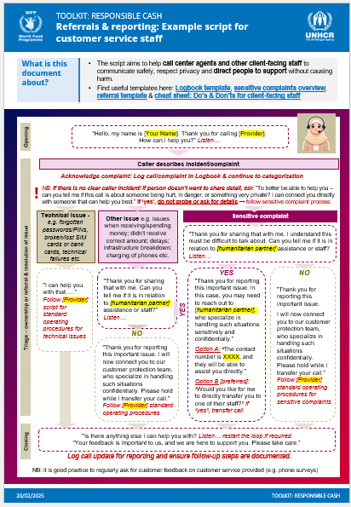
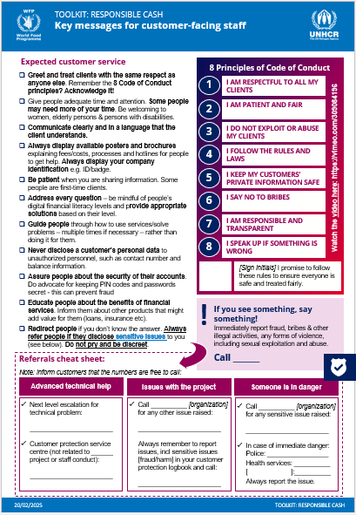
Questions? Share handouts
FSP reporting & referrals script
Key messages for client-facing staff

